Slide 1
Reading Expository Text
How to become a better reader.
by S. Nelson & M. Wells
J. Barker Elementary 2006

Slide 2
Teachers need to teach students how to read each type of text as they encounter it if they are to read them successfully.
A book on a fireman’s job is an expository text.
Being able to identify the patterns of expository text will increase comprehension resulting in
effective, successful readers.

Slide 3
Expository Text
Expository text makes up the bulk of (most of) what adults read.
teachers read text books
policemen read reports and records
lawyers read legal papers
veterinarians read medical books
In school, after 2nd or 3rd grade, this is also true.
(Often the only exception is reading fiction books
during A. R. time).

Slide 4
Therefore, students need to know:
how to identify text structure
how this type of text structure works,
how you should prepare to read it,
& what to do once you begin reading expository texts.

Slide 5
Expository Texts include:
text books,
non-fiction trade (library) books,
newspaper & magazine articles,
directions,
essays,
speeches,
user manuals (how-to guides),
government documents (such as the driver’s license test booklet).

Slide 6
There are certain elements found in expository text, each type of element makes its own demands on the reader:
description,
sequence,
comparison,
cause & effect,
problem & solution.

Slide 7
Elements of Expository Text:
1. description – The author lists characteristics, features, and examples to describe a subject. Clue words for description include for example & characteristics.
Have wings
use soundwaves
they are mammals
eat insects
They fly
Bats
hang upside down
sleep in daytime
different
kinds

Slide 8
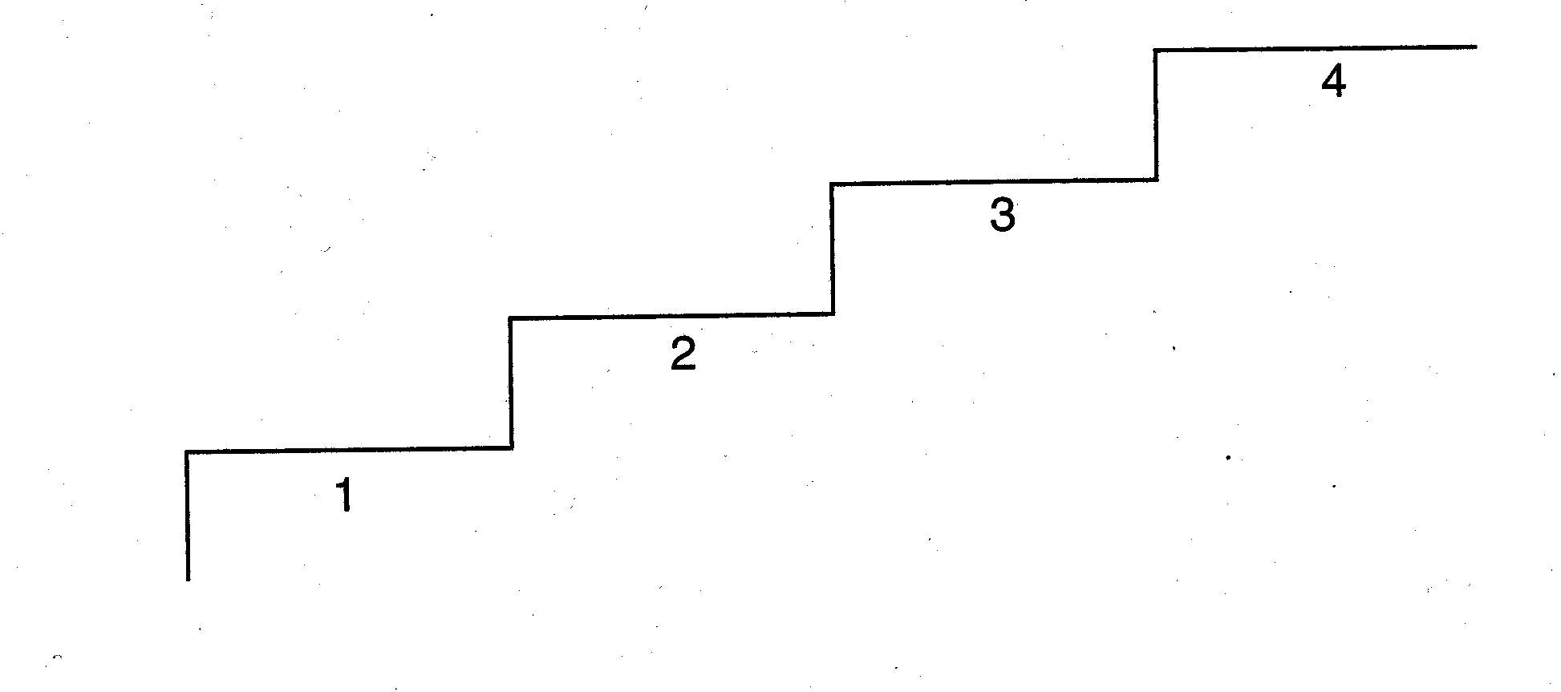
Elements of Expository Text:
2. sequence – The author lists items or events in numerical or chronological order. Clue words include first, second, third, next, then and finally.
Almost 300 males
competed in the
1896 Olympics
Modern Olympics
began in 1896
Olympics ended
in 394 A.D.
Olympics began
in 276 B.C.

Slide 9
Elements of Expository Text:
3. comparison – The author explains how two or more things are alike or different. Clue words include different, in contrast, alike, same as, or on the other hand.
no snow
warmer temperatures
flowers
baby animals
Easter & 4th of July
seasons – sun shines
sports are played
Summer and Winter
snow
colder temperatures
no flowers blooming
bears hibernate
Christmas & New Years

Slide 10
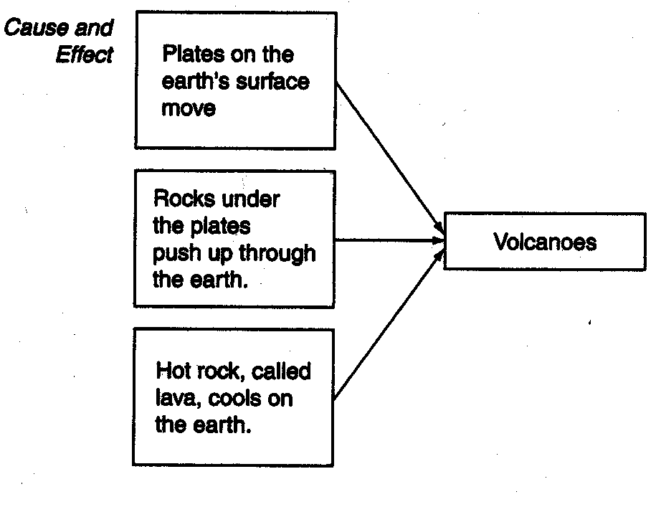
Elements of Expository Text:
4. cause & effect – The author explains one or more causes and the resulting effect or effects. Clue words are reasons why, if, then, as a result, therefore, and because.

Slide 11
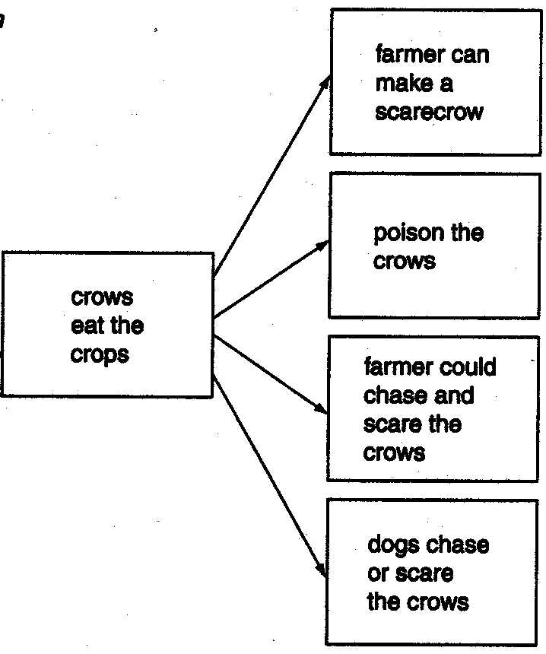
Elements of Expository Text:
5. problem & solution – The author states a problem and lists one or more solutions for the problem. Clue words are problem is, dilemma is, puzzle is, solve, question, and answer.

Slide 12
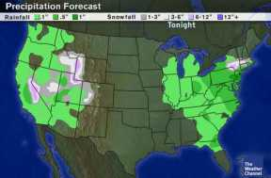
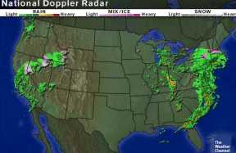
For example, a weatherman would use an expository text to explain the causes and consequences of the weather, drawing examples from various sources to illustrate (to show) his points, perhaps even including a graph/map or some photographs.
Precipitation Map
Radar Map

Slide 13
Follow These Steps When Reading Expository Text
Review
1. Learn how to use the comprehension aids in content area textbooks, including:
chapter overviews,
headings that outline the chapter,
helpful graphics,
technical words defined in text, and
end-of-chapter summaries.

Slide 14
2. Create questions before reading.
Before reading each section of a chapter:
you should turn the section heading into a question and read the section to find the answer to the question
as you read, you should take notes, &
then you should answer the questions you created.

Slide 15
3. Identify Expository Text Structures
learn the 5 expository text structures (description, sequence, comparison, cause & effect, and problem & solution)
identify the text structure in the section as you read

Slide 16
4. Pay attention to the Key Terms
teachers should assist by introducing the key terms that will be presented in the text
find the meaning of these key words as you read the selection – often these terms will be bold type or defined in the text

Slide 17
5. Focus on Main Ideas
stay focused on the overall information (the main idea) being presented in each section as you read
creating an outline or taking notes as you read will make it easier to remember the main ideas

Slide 18
6. Use Activities & Graphic Organizers to enhance meaning
begin with activities such as brainstorming and KWL (know, want to know, and learned)
graphic organizers such as webs, Venn Diagrams, and note taking to enhance meaning of text

Slide 19
7. Use Headings
use headings to select and organize information
students can add details to the headings as they read

Slide 20
8. Ask Self-Questions
become active read by asking yourself questions as you read
monitor your comprehension of the text through your questions and responses

Slide 21
9. Use Listen-Read-Discuss Format
in a class setting, the teacher should present key concepts orally to the class
students then read and discuss the text
finally, students review the selection making sure to go over the main ideas presented in the text

Slide 22
10. Create Text Sets
in a class setting, the teacher should supplement textbook assignments with information from a variety of sources such as:
 other non-fiction books
 internet sources
 PowerPoint® presentations
 fictional stories and poems

Slide 23
Warning – ahead…
Mature (older) readers should identify the source (i.e., the original publication and date) of the article – especially IF they are using the article to support their own research.
Outdated information or inaccurate (not correct) sources can lead to problems with their own papers/speeches/and can even lead to legal (courts and lawyers) problems.

