Slide 1
Greek Root Words

Slide 2

Sound
Telephone
Microphone
Phonics

Slide 3
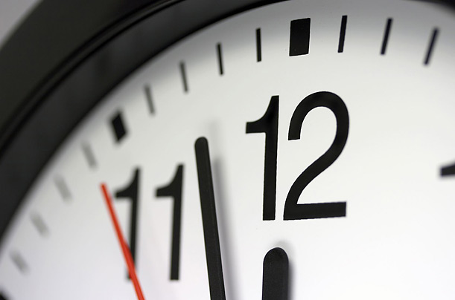
Time
Chronicle
Chronic
Chronology

Slide 4

Self
Automobile
Automatic
Autostart

Slide 5



circle
Motorcycle
Unicycle
Bicycle
Recycle
circle

Slide 6
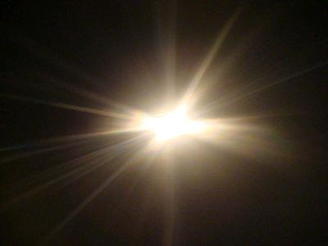
Light
Photo
Photograph
Photosynthesis
Photocopy

Slide 7
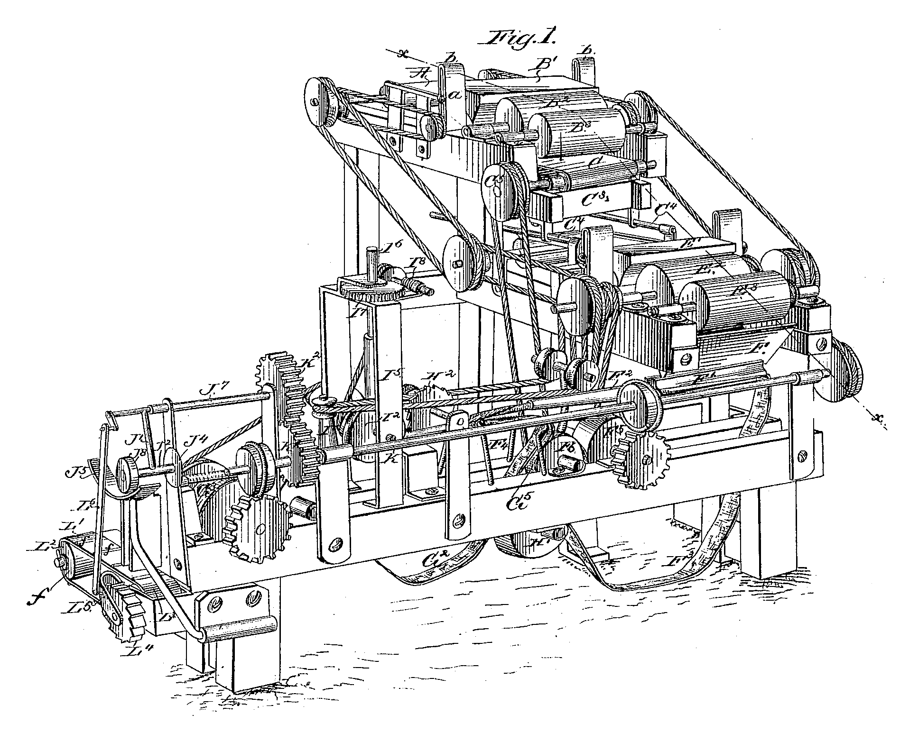
Tools
Mechanics
Mechanism

Slide 8

The study of
Biology
Physiology
Technology

Slide 9

Written or Drawn
Graph
Biography
Bibliography

Slide 10
Measure
Symmetry
Geometry
Meter

Slide 11
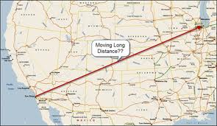
Distant (far)
Telephone
Telegraph
Television

Slide 12

Life
Biography
Biology

Slide 13
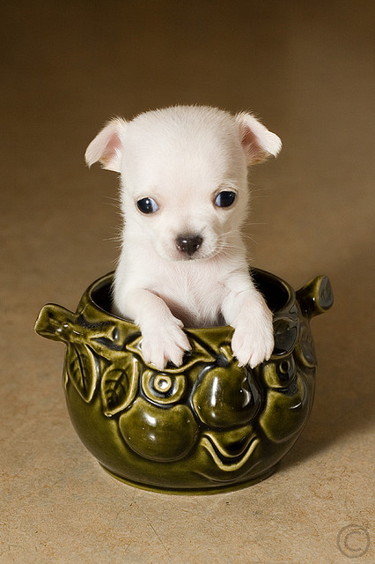
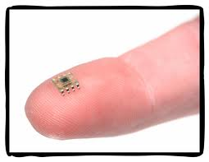
Small or minute
Microchip
Microscope
Microscopic

Slide 14
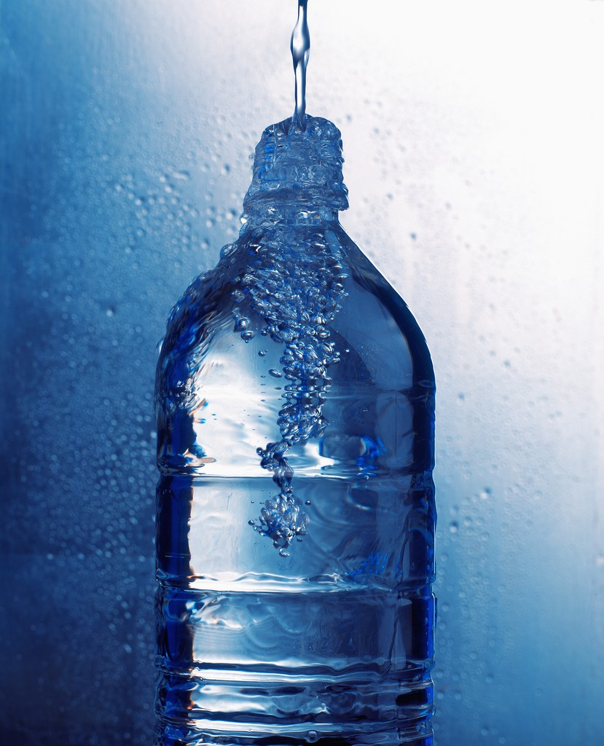
Water
Dehydrate
Hydrate
Dehydration

Slide 15
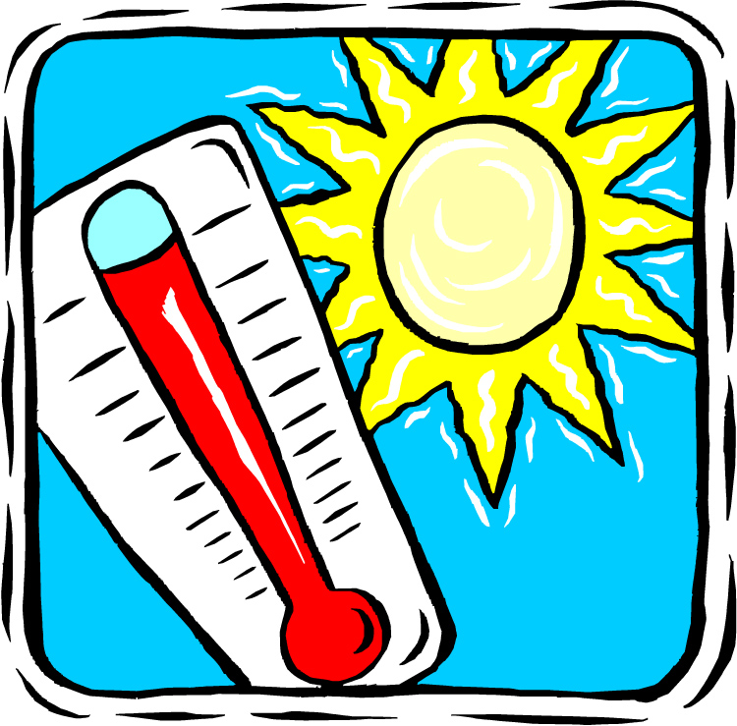
Heat or Hot
Thermometer
Thermostat
Thermos

Slide 16

rule or govern
Democracy
Democrat

Slide 17
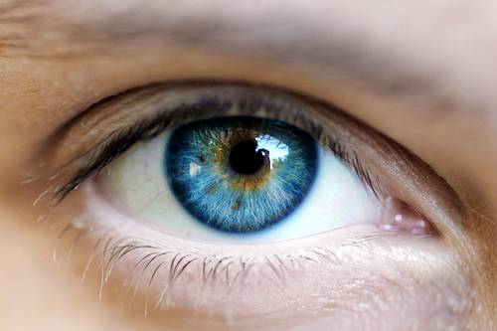
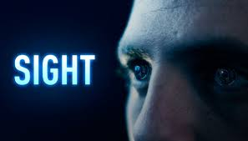
see or sight
Microscope
Telescope

