Slide 1
Understanding Text Structures

Slide 2
What is a text structure?
A “structure” is a building or framework
“Text structure” refers to how a piece of text is built

Slide 3
What is a text structure?
Builders can use different kinds of structures to build different things
A skyscraper, for example, is a different kind of structure from a house

Slide 4
What is a text structure?
Writers use different structures to build their ideas
Each text structure communicates ideas in a different way

Slide 5
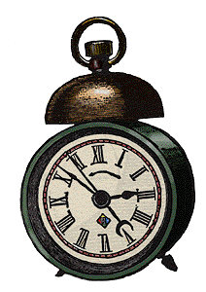
Chronological order
Authors use chronological order to explain how things happen in order
Chronological order is also called sequence or time order

Slide 6
Chronological order
You will know that you are reading a text in chronological order because you will see words like first, next, later, then, and finally

Slide 7
Chronological order
You will often see chronological order in directions:
Have you ever made macaroni and cheese? It’s simple! First, boil some water and make some macaroni. Then, make your cheese sauce. After the cheese sauce is ready, mix it with the macaroni. Bake the entire thing in the oven. Finally, it’s time to eat!

Slide 8
Chronological order
You will often see chronological order in directions:
Have you ever made macaroni and cheese? It’s simple! First, boil some water and make some macaroni. Then, make your cheese sauce. After the cheese sauce is ready, mix it with the macaroni. Bake the entire thing in the oven. Finally, it’s time to eat!

Slide 9
Which paragraph is in chronological order?
Pennsylvania has many historic sites. You can visit Revolutionary war sites, like Valley Forge. You can also visit important locations from the Civil War, like Gettysburg. Finally, you can also see the site of the first oil well in Titusville. Pennsylvania has many neat places to visit!
Through the ages, Pennsylvania has seen many interesting events. The state was founded in 1681 by William Penn. Later, Pennsylvania was the site of important Revolutionary War battles. After that, Pennsylvania was home to new factories during the Industrial Revolution. Today, Pennsylvania continues to make history.

Slide 10
Which paragraph is in chronological order?
Through the ages, Pennsylvania has seen many interesting events. The state was founded in 1681 by William Penn. Later, Pennsylvania was the site of important Revolutionary War battles. After that, Pennsylvania was home to new factories during the Industrial Revolution. Today, Pennsylvania continues to make history.
This is the paragraph in chronological order. Can you find the clue words that show this order?

Slide 11
Which paragraph is in chronological order?
Through the ages, Pennsylvania has seen many interesting events. The state was founded in 1681 by William Penn. Later, Pennsylvania was the site of important Revolutionary War battles. After that, Pennsylvania was home to new factories during the Industrial Revolution. Today, Pennsylvania continues to make history.
This is the paragraph in chronological order. Can you find the clue words that show this order?

Slide 12
Think about it!
What is a structure?
What does chronological order mean?
What are some clue words that show chronological order?

Slide 13
Another text structure
But what if an author doesn’t want to show how something happened in sequence?
The author would need to use another text structure!

Slide 14
Another text structure
Suppose an author wanted to explain how these two birds are similar and different
Chronological order wouldn’t work---there is no order of events
The author would need to use compare and contrast

Slide 15
Another text structure
The cardinal and the cedar waxwing are two common birds. Both have crests on their heads. Both are common at birdfeeders. But the birds have some differences. The male cardinal is a bright red, while the waxwing is brown. The cedar waxwing often migrates from place to place. On the other hand, the cardinal stays in one place year after year.

Slide 16
Compare and contrast clue words
When authors use the text structure of compare and contrast, they often use special clue words to show this text structure.
Can you find the clue words in the paragraph?

Slide 17
Can you find the clue words?
The cardinal and the cedar waxwing are two common birds. Both have crests on their heads. Both are common at birdfeeders. But the birds have some differences. The male cardinal is a bright red, while the waxwing is brown. The cedar waxwing often migrates from place to place. On the other hand, the cardinal stays in one place year after year.

Slide 18
Here they are!
The cardinal and the cedar waxwing are two common birds. Both have crests on their heads. Both are common at birdfeeders. But the birds have some differences. The male cardinal is a bright red, while the waxwing is brown. The cedar waxwing often migrates from place to place. On the other hand, the cardinal stays in one place year after year.

Slide 19
Compare and contrast graphic organizer
To organize details from a paragraph in compare and contrast, use a Venn diagram

Slide 20
Review
Can you explain the difference between chronological order and compare and contrast?
How can clue words help you as a reader?

Slide 21
Another text structure
Sometimes, a writer will want to explain how one event leads to another
This kind of text structure is called cause and effect

Slide 22
Cause and effect clue words
When authors write paragraphs to show causes and effects, they use words like cause, effect, as a result, consequently, and so

Slide 23
Can you find the clue words?
The night’s snowstorm had many effects. People were out shoveling snow from their sidewalks. The power lines were draped with ice. Snow plows drove down every street. Children were the happiest of all. The unexpected snow caused school to be cancelled!

Slide 24
Can you find the clue words?
The night’s snowstorm had many effects. People were out shoveling snow from their sidewalks. The power lines were draped with ice. Snow plows drove down every street. Children were the happiest of all. The unexpected snow caused school to be cancelled!

Slide 25
More with cause and effect
Baby painted turtles spend all winter in their nests. They have special chemicals in their blood that can keep their blood from freezing. As a result, baby painted turtles can survive freezing temperatures!

Slide 26
More with cause and effect
Baby painted turtles spend all winter in their nests. They have special chemicals in their blood that can keep their blood from freezing. As a result, baby painted turtles can survive freezing temperatures!
This is the cause

Slide 27
More with cause and effect
Baby painted turtles spend all winter in their nests. They have special chemicals in their blood that can keep their blood from freezing. As a result, baby painted turtles can survive freezing temperatures!
This is the effect

Slide 28
Review
Which text structure tells about how things are similar and different?
Compare and contrast
Which text structure explains how things happen in time order?
Chronological order

Slide 29
Another kind of text structure
Sometimes, an author will want to explain a problem, and then show one or more solutions
This kind of text structure is called problem and solution

Slide 30
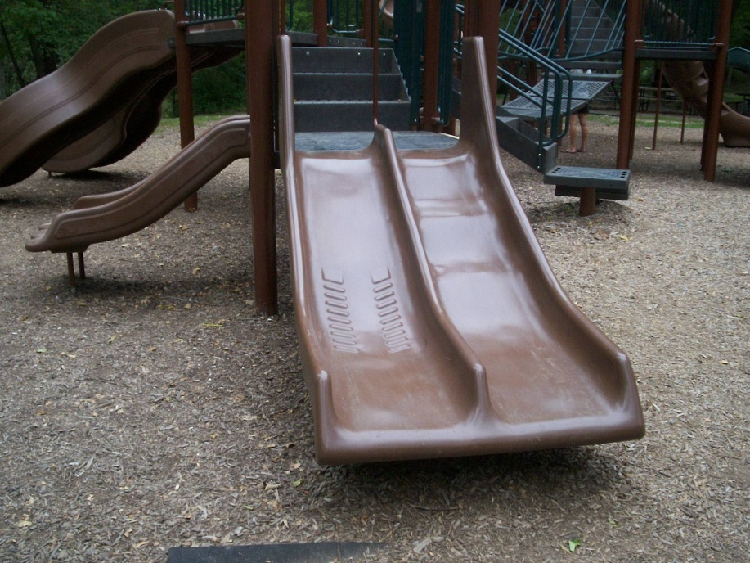
An example of problem and solution
Park School had a terrible problem. Every day at recess, students would argue over the slides. Teachers had to spend time every day taking care of the arguments. Finally, one teacher came up with a great solution. They bought another set of slides that everyone could enjoy.

Slide 31
An example of problem and solution
Park School had a terrible problem. Every day at recess, students would argue over the slides. Teachers had to spend time every day taking care of the arguments. Finally, one teacher came up with a great solution. They bought another set of slides that everyone could enjoy.
Can you find the problem and the solution in this paragraph?

Slide 32
An example of problem and solution
Park School had a terrible problem. Every day at recess, students would argue over the slides. Teachers had to spend time every day taking care of the arguments. Finally, one teacher came up with a great solution. They bought another set of slides that everyone could enjoy.
Here is the problem

Slide 33
An example of problem and solution
Park School had a terrible problem. Every day at recess, students would argue over the slides. Teachers had to spend time every day taking care of the arguments. Finally, one teacher came up with a great solution. They bought another set of slides that everyone could enjoy.
Here is the problem
Here is the solution

Slide 34
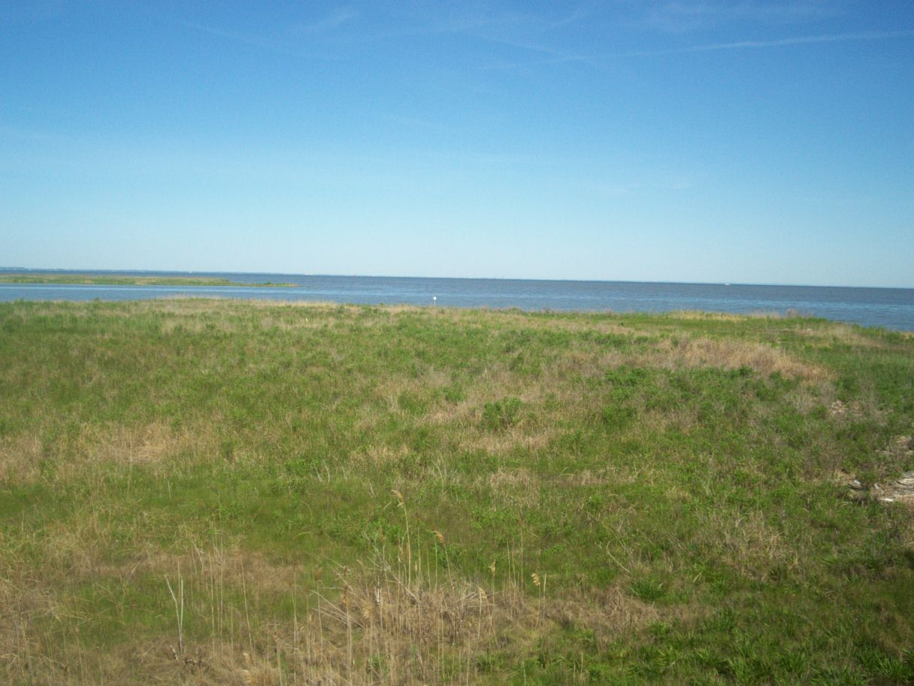
Of course, problem and solution is not always so simple
Often, authors will signal problem and solution structure with clue words like problem and solution, just like in the last paragraph
Sometimes, authors will use related words

Slide 35
Of course, problem and solution is not always so simple
Synonyms for problem include difficulty, struggle, uncertainty, worry, threat, and trouble
Synonyms for solution include possibility, hope, bright spot, answer, and future

Slide 36

A more difficult problem and solution paragraph
The Chesapeake Bay faces an uncertain future. Issues such as pesticides, too many nutrients, and habitat loss all threaten the Bay’s water quality and animal life. However, scientists are hopeful that the future may be brighter. If everyone in the Chesapeake Bay watershed works together, solutions may be found.

Slide 37
A more difficult problem and solution paragraph
The Chesapeake Bay faces an uncertain future. Issues such as pesticides, too many nutrients, and habitat loss all threaten the Bay’s water quality and animal life. However, scientists are hopeful that the future may be brighter. If everyone in the Chesapeake Bay watershed works together, solutions may be found.
What is the problem?
What is the solution?

Slide 38
A more difficult problem and solution paragraph
The Chesapeake Bay faces an uncertain future. Issues such as pesticides, too many nutrients, and habitat loss all threaten the Bay’s water quality and animal life. However, scientists are hopeful that the future may be brighter. If everyone in the Chesapeake Bay watershed works together, solutions may be found.
Problem
Solution

Slide 39
Text structures we’ve learned so far
Chronological order
Compare and contrast
Cause and effect
Problem and solution

Slide 40
Match the clue words!
Can you figure out the text structure that these clue words point to?
however, on the other hand, similarity, like, unlike
Compare and contrast

Slide 41
Match the clue words!
Can you figure out the text structure that these clue words point to?
as a result, consequently, therefore, so, cause, effect
Cause and effect

Slide 42
Match the clue words!
Can you figure out the text structure that these clue words point to?
problem, solution, threat, difficulty, hope, answer, possibility
Problem and solution

Slide 43
Are there any other text structures?
Most paragraphs that we write in school can be called main idea, description, or statement and support paragraphs

Slide 44
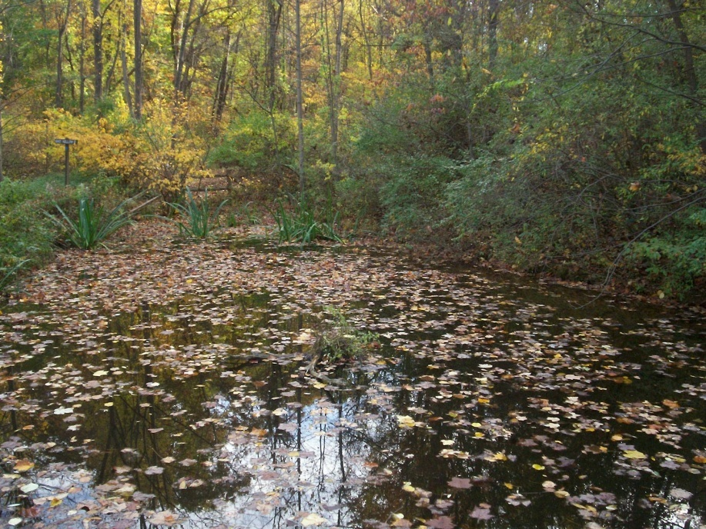
Main idea paragraphs
In this kind of paragraph, the author offers a main idea statement, and then supports that statement with several details

Slide 45
Main idea paragraphs
The pond was a beautiful place to visit. The falling leaves, all different colors, decorated the surface of the water. At the edges of the pond, small wildflowers grew. The golden forest glowed faintly in the distance.

Slide 46
Main idea paragraphs
Main idea
The pond was a beautiful place to visit. The falling leaves, all different colors, decorated the surface of the water. At the edges of the pond, small wildflowers grew. The golden forest glowed faintly in the distance.

Slide 47
Main idea paragraphs
Main idea
The pond was a beautiful place to visit. The falling leaves, all different colors, decorated the surface of the water. At the edges of the pond, small wildflowers grew. The golden forest glowed faintly in the distance.
All of the other sentences explain why the main idea is true

Slide 48
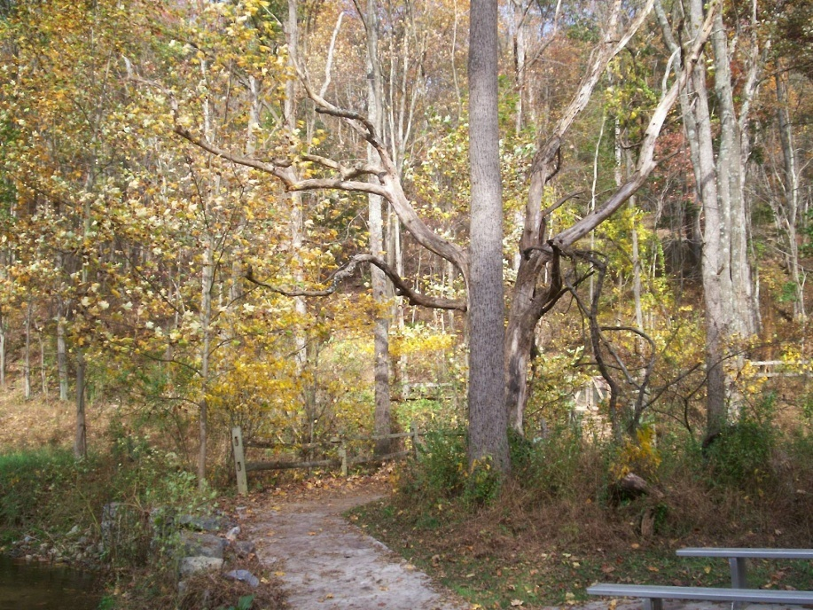
Main idea paragraphs
Clue words in these paragraphs may include:
One reason, another reason, and for example

Slide 49
Now it’s your turn!
On the next few slides, you will read some paragraphs about the Great Chicago Fire
Your task is to decide on the text structure for each one
Understanding the text structure will help you to understand each paragraph

Slide 50
What’s the text structure?
Daniel Sullivan was the first to notice the flames coming from the O’Leary barn at around 8:30 pm on October 8. A problem with the alarm box made it impossible for the people in the area to call for the fire department. By 9:30 pm, the entire block was blazing. In another 3 hours, there were fires all over Chicago. The heavy wind coming from the lake only made the fire bigger. It would be another day before the fire would be completely out. By that time, 17,500 buildings had been burned.
Chronological order
Compare and contrast
Cause and effect
Problem and solution
Main idea

Slide 51
What’s the text structure?
Daniel Sullivan was the first to notice the flames coming from the O’Leary barn at around 8:30 pm on October 8. A problem with the alarm box made it impossible for the people in the area to call for the fire department. By 9:30 pm, the entire block was blazing. In another 3 hours, there were fires all over Chicago. The heavy wind coming from the lake only made the fire bigger. It would be another day before the fire would be completely out. By that time, 17,500 buildings had been burned.
Chronological order
Compare and contrast
Problem and solution

Slide 52
What’s the text structure?
Daniel Sullivan was the first to notice the flames coming from the O’Leary barn at around 8:30 pm on October 8. A problem with the alarm box made it impossible for the people in the area to call for the fire department. By 9:30 pm, the entire block was blazing. In another 3 hours, there were fires all over Chicago. The heavy wind coming from the lake only made the fire bigger. It would be another day before the fire would be completely out. By that time, 17,500 buildings had been burned.
Chronological order

Slide 53
What’s the text structure?
Daniel Sullivan was the first to notice the flames coming from the O’Leary barn at around 8:30 pm on October 8. A problem with the alarm box made it impossible for the people in the area to call for the fire department. By 9:30 pm, the entire block was blazing. In another 3 hours, there were fires all over Chicago. The heavy wind coming from the lake only made the fire bigger. It would be another day before the fire would be completely out. By that time, 17,500 buildings had been burned.
Chronological order

Slide 54
What’s the text structure?
Daniel Sullivan was the first to notice the flames coming from the O’Leary barn at around 8:30 pm on October 8. A problem with the alarm box made it impossible for the people in the area to call for the fire department. By 9:30 pm, the entire block was blazing. In another 3 hours, there were fires all over Chicago. The heavy wind coming from the lake only made the fire bigger. It would be another day before the fire would be completely out. By that time, 17,500 buildings had been burned.
Chronological order
Notice how the paragraph shows how events happen in time order

Slide 55
What’s the text structure?
Daniel Sullivan was the first to notice the flames coming from the O’Leary barn at around 8:30 pm on October 8. A problem with the alarm box made it impossible for the people in the area to call for the fire department. By 9:30 pm, the entire block was blazing. In another 3 hours, there were fires all over Chicago. The heavy wind coming from the lake only made the fire bigger. It would be another day before the fire would be completely out. By that time, 17,500 buildings had been burned.
Understanding that this text is written in chronological order can help you to understand how the Great Fire started

Slide 56
Try another!
Chronological order
Compare and contrast
Cause and effect
Problem and solution
Main idea
Why was the Great Chicago Fire so disastrous? After all, Chicago had fire departments and fire alarms. One reason for the terrible fire is that the alarm malfunctioned. The local fire company noticed the fire by accident as it was returning from another fire. As another problem, a watchman who saw the flames directed other fire companies to a location that was nearly a mile away from the fire. Because of these two problems, a fire that could have been controlled rapidly spread across the city.

Slide 57
Try another!
Compare and contrast
Cause and effect
Problem and solution
Why was the Great Chicago Fire so disastrous? After all, Chicago had fire departments and fire alarms. One reason for the terrible fire is that the alarm malfunctioned. The local fire company noticed the fire by accident as it was returning from another fire. As another problem, a watchman who saw the flames directed other fire companies to a location that was nearly a mile away from the fire. Because of these two problems, a fire that could have been controlled rapidly spread across the city.

Slide 58
Try another!
Cause and effect
Why was the Great Chicago Fire so disastrous? After all, Chicago had fire departments and fire alarms. One reason for the terrible fire is that the alarm malfunctioned. The local fire company noticed the fire by accident as it was returning from another fire. As another problem, a watchman who saw the flames directed other fire companies to a location that was nearly a mile away from the fire. Because of these two problems, a fire that could have been controlled rapidly spread across the city.

Slide 59
Try another!
Cause and effect
Notice how the causes (in blue) lead to the effect (in yellow)
Why was the Great Chicago Fire so disastrous? After all, Chicago had fire departments and fire alarms. One reason for the terrible fire is that the alarm malfunctioned. The local fire company noticed the fire by accident as it was returning from another fire. As another problem, a watchman who saw the flames directed other fire companies to a location that was nearly a mile away from the fire. Because of these two problems, a fire that could have been controlled rapidly spread across the city.

Slide 60
What text structure is here?
After the fire, thousands of people were left homeless. Many escaped the fire with nothing except the clothes on their backs. Providing all of these people with food, clean water, and shelter was a huge task. Luckily, the city quickly formed a Relief and Aid Society. This group started giving out the food donations that were pouring in from other cities. The society built places for people to live, gathered the tools that people needed to rebuild their houses, and even vaccinated 64,000 people against smallpox.
Chronological order
Compare and contrast
Cause and effect
Problem and solution
Main idea

Slide 61
What text structure is here?
After the fire, thousands of people were left homeless. Many escaped the fire with nothing except the clothes on their backs. Providing all of these people with food, clean water, and shelter was a huge task. Luckily, the city quickly formed a Relief and Aid Society. This group started giving out the food donations that were pouring in from other cities. The society built places for people to live, gathered the tools that people needed to rebuild their houses, and even vaccinated 64,000 people against smallpox.
Chronological order
Cause and effect
Problem and solution

Slide 62
What text structure is here?
After the fire, thousands of people were left homeless. Many escaped the fire with nothing except the clothes on their backs. Providing all of these people with food, clean water, and shelter was a huge task. Luckily, the city quickly formed a Relief and Aid Society. This group started giving out the food donations that were pouring in from other cities. The society built places for people to live, gathered the tools that people needed to rebuild their houses, and even vaccinated 64,000 people against smallpox.
Problem and solution

Slide 63
What text structure is here?
After the fire, thousands of people were left homeless. Many escaped the fire with nothing except the clothes on their backs. Providing all of these people with food, clean water, and shelter was a huge task. Luckily, the city quickly formed a Relief and Aid Society. This group started giving out the food donations that were pouring in from other cities. The society built places for people to live, gathered the tools that people needed to rebuild their houses, and even vaccinated 64,000 people against smallpox.
Problem and solution
Here is the problem

Slide 64
What text structure is here?
After the fire, thousands of people were left homeless. Many escaped the fire with nothing except the clothes on their backs. Providing all of these people with food, clean water, and shelter was a huge task. Luckily, the city quickly formed a Relief and Aid Society. This group started giving out the food donations that were pouring in from other cities. The society built places for people to live, gathered the tools that people needed to rebuild their houses, and even vaccinated 64,000 people against smallpox.
Problem and solution
Here is the solution

Slide 65
Can you find the text structure?
Chicago changed in many ways after the fire. Before the fire, most of the buildings were less than five stories high. The buildings that were constructed after the fire, however, were some of the first skyscrapers in the country. Before the fire, most of the houses were made of wood. After the fire, people chose to build their houses out of stone or brick. There were changes in where people lived, as well. The poor people in the city lived close to the center of the city before the fire. After the fire, they moved into neighborhoods that were farther away from the downtown area.
Chronological order
Compare and contrast
Cause and effect
Problem and solution
Main idea

Slide 66
Can you find the text structure?
Chicago changed in many ways after the fire. Before the fire, most of the buildings were less than five stories high. The buildings that were constructed after the fire, however, were some of the first skyscrapers in the country. Before the fire, most of the houses were made of wood. After the fire, people chose to build their houses out of stone or brick. There were changes in where people lived, as well. The poor people in the city lived close to the center of the city before the fire. After the fire, they moved into neighborhoods that were farther away from the downtown area.
Compare and contrast
Cause and effect
Main idea

Slide 67
Can you find the text structure?
Chicago changed in many ways after the fire. Before the fire, most of the buildings were less than five stories high. The buildings that were constructed after the fire, however, were some of the first skyscrapers in the country. Before the fire, most of the houses were made of wood. After the fire, people chose to build their houses out of stone or brick. There were changes in where people lived, as well. The poor people in the city lived close to the center of the city before the fire. After the fire, they moved into neighborhoods that were farther away from the downtown area.
Compare and contrast

Slide 68
Can you find the text structure?
Chicago changed in many ways after the fire. Before the fire, most of the buildings were less than five stories high. The buildings that were constructed after the fire, however, were some of the first skyscrapers in the country. Before the fire, most of the houses were made of wood. After the fire, people chose to build their houses out of stone or brick. There were changes in where people lived, as well. The poor people in the city lived close to the center of the city before the fire. After the fire, they moved into neighborhoods that were farther away from the downtown area.
Compare and contrast
Notice how this paragraph is comparing Chicago BEFORE the fire to Chicago AFTER the fire

Slide 69
Can you find the text structure?
Chicago changed in many ways after the fire. Before the fire, most of the buildings were less than five stories high. The buildings that were constructed after the fire, however, were some of the first skyscrapers in the country. Before the fire, most of the houses were made of wood. After the fire, people chose to build their houses out of stone or brick. There were changes in where people lived, as well. The poor people in the city lived close to the center of the city before the fire. After the fire, they moved into neighborhoods that were farther away from the downtown area.
Compare and contrast
Notice how this paragraph is comparing Chicago BEFORE the fire to Chicago AFTER the fire

Slide 70
One more paragraph!
By Monday night, the town of Chicago was burning. People described it as terrible, but amazing. The flames were brighter than anything people had ever seen. The harsh winds swept the fire across the city with terrible speed. For many who watched, it was a sight to remember for the rest of their lives.
Chronological order
Compare and contrast
Cause and effect
Problem and solution
Main idea

Slide 71
One more paragraph!
By Monday night, the town of Chicago was burning. People described it as terrible, but amazing. The flames were brighter than anything people had ever seen. The harsh winds swept the fire across the city with terrible speed. For many who watched, it was a sight to remember for the rest of their lives.
Compare and contrast
Cause and effect
Main idea

Slide 72
One more paragraph!
By Monday night, the town of Chicago was burning. People described it as terrible, but amazing. The flames were brighter than anything people had ever seen. The harsh winds swept the fire across the city with terrible speed. For many who watched, it was a sight to remember for the rest of their lives.
Main idea

Slide 73
One more paragraph!
By Monday night, the town of Chicago was burning. People described it as terrible, but amazing. The flames were brighter than anything people had ever seen. The harsh winds swept the fire across the city with terrible speed. For many who watched, it was a sight to remember for the rest of their lives.
Main idea
Notice the main idea

Slide 74
One more paragraph!
By Monday night, the town of Chicago was burning. People described it as terrible, but amazing. The flames were brighter than anything people had ever seen. The harsh winds swept the fire across the city with terrible speed. For many who watched, it was a sight to remember for the rest of their lives.
Main idea
Notice the main idea
The rest of the sentences explain the main idea

Slide 75
What have you learned about text structures?
Share your ideas with a partner
Be sure to explain how you can find the text structure of a paragraph

Slide 76
by Emily Kissner

